Slide 1
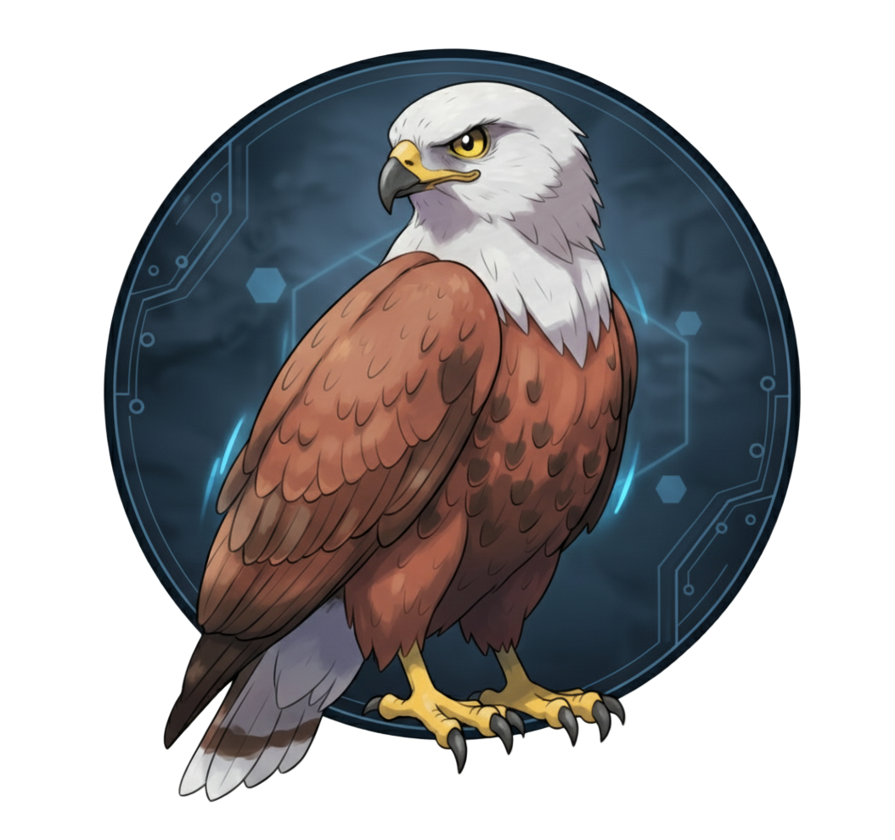
Project HAWKEYE

Slide 2

Laser Triggered SMS Alert System
Innovation Lab Project (PH4049201)
Presented by:
Tanmoy Bhakat- 24PH40053
Tushar Majhi-24PH40055
Himanshi-24PH40021
Rohit Bauri-24PH40037
Sayantan Samanta-24PH40041
Indian Institute of Technology, Kharagpur
Department of Physics
M.Sc. Physics

Slide 3

Objective:
To detect intrusion by sensing interruption in the laser beam using LDR.
To trigger a buzzer and LEDs instantly when the beam is broken.
To send an instant SMS alert to the user via Telegram using ESP32 Wi-Fi.
To design a simple and low-cost IoT-based security alert system.

Slide 4
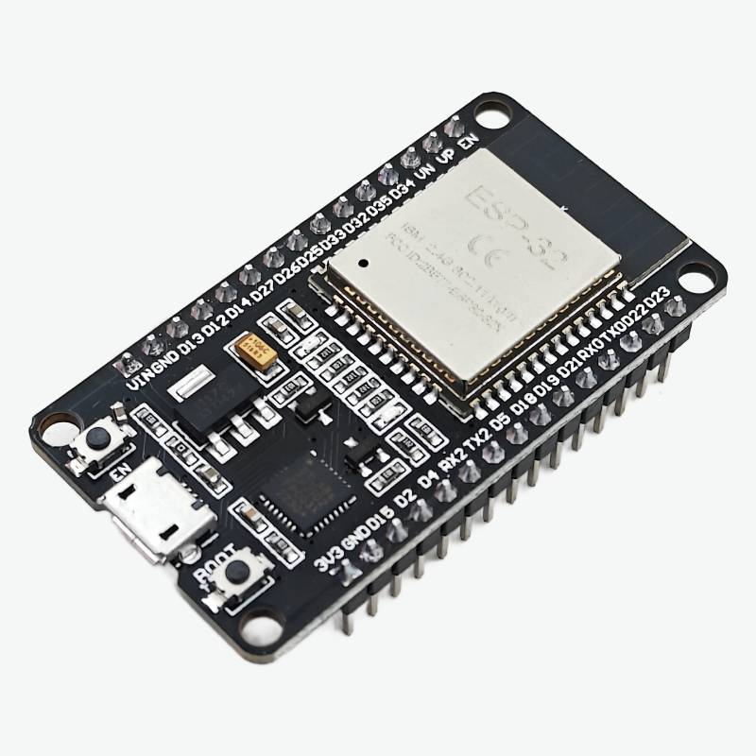
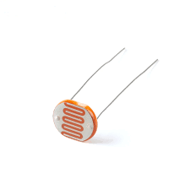
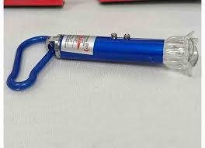
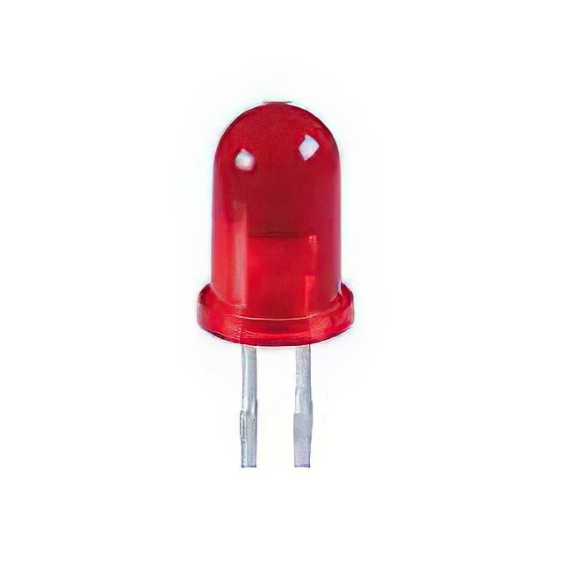
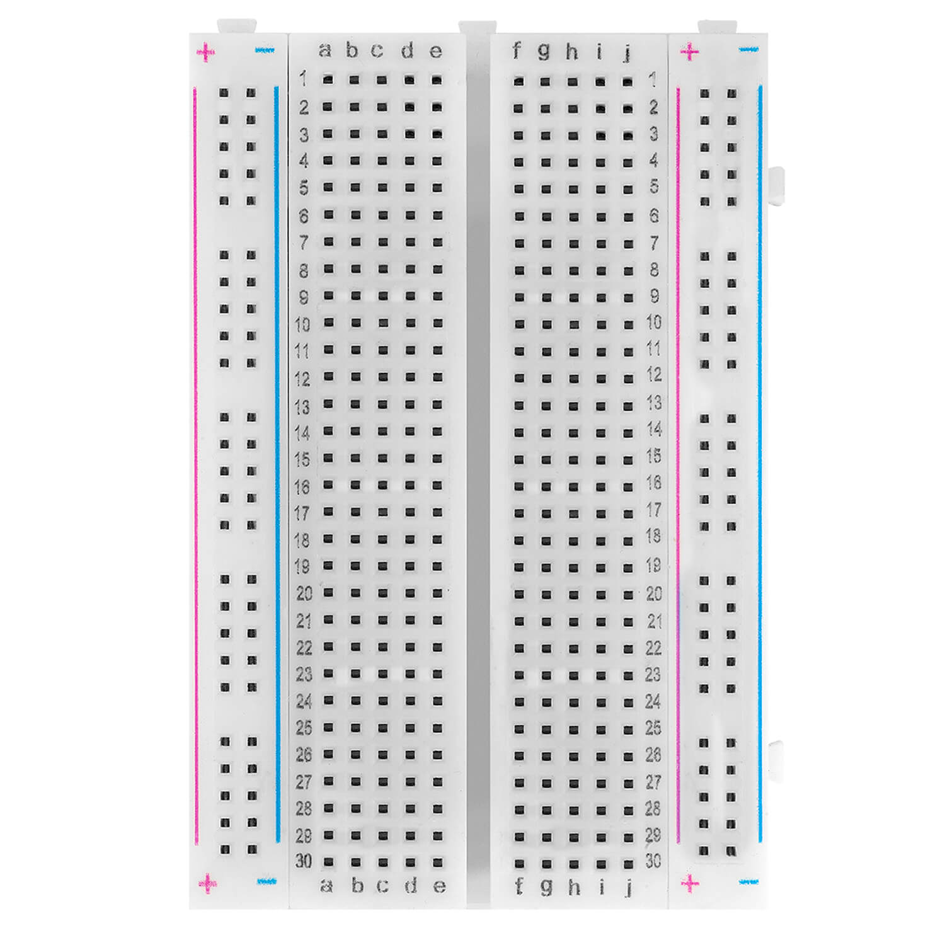
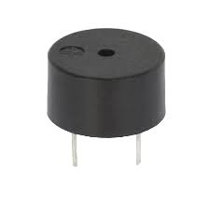
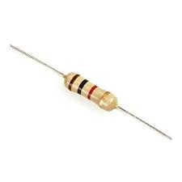
Component Selection & design:
1. ESP-32
2. LASER
3. LDR
4. LED
5. Buzzer
6. Resistance
7. Breadboard

Slide 5
Function of Components:
ESP-32: Main controller that detects a signal change from LDR and sends a message alert to the mobile.
Laser: Provides a continuous light beam focused on the LDR.
LDR: Senses the laser light; its resistance changes when the beam is interrupted.
LED: Glows when the beam is interrupted to give visual indication.
Buzzer: Produces a sound when the beam is broken as an alert.
Resistor: Controls current and protects components from damage.
Breadboard: Used to connect all components easily without soldering.

Slide 6
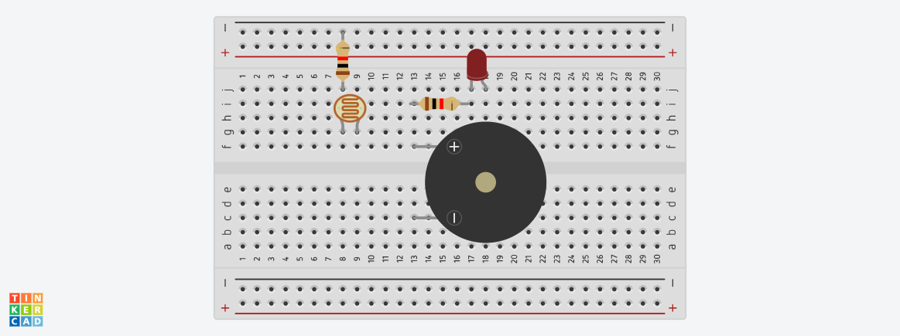
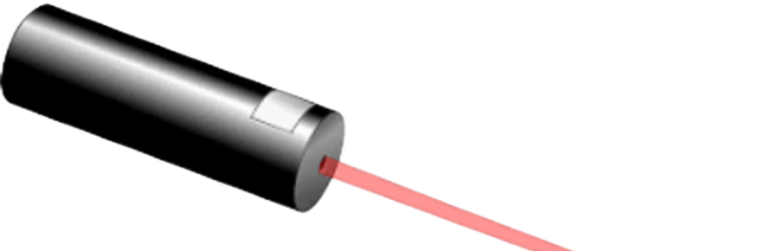
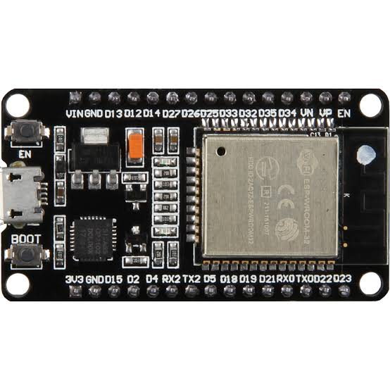
Circuit Diagram:
LDR
LED
LASER
Buzzer
ESP-32

Slide 7
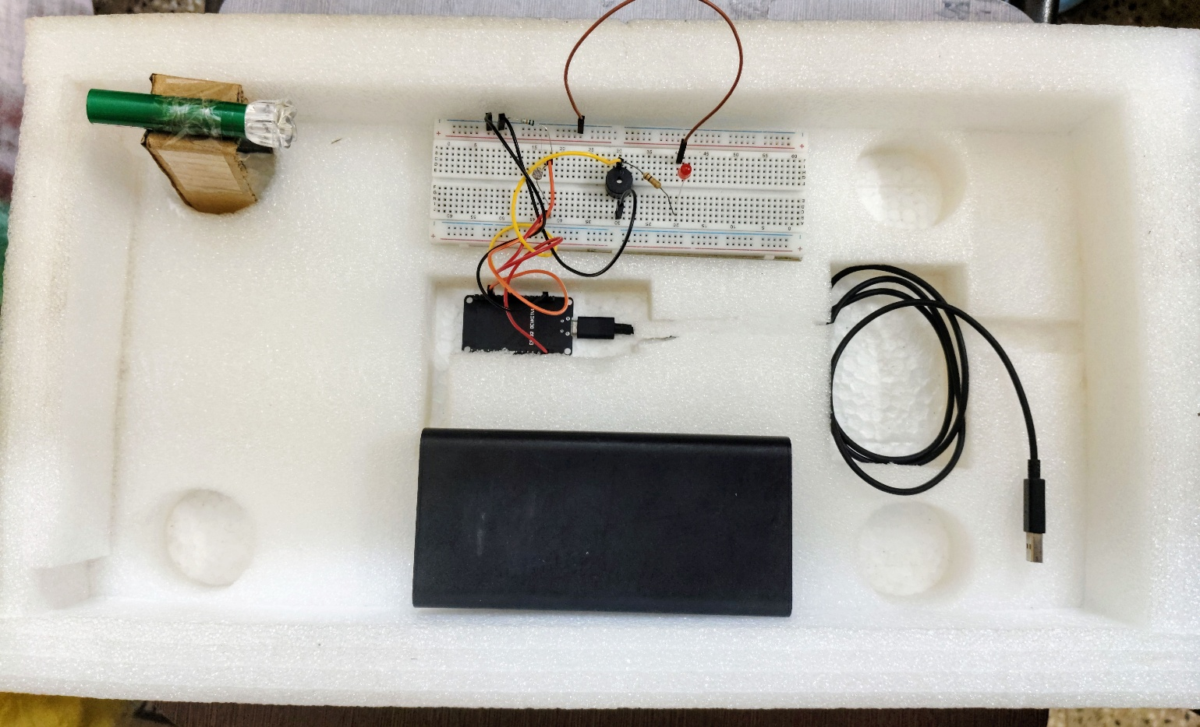
Device Assembly:

Slide 8
Working Principle:
A laser beam is continuously directed toward the LDR.
When the beam is uninterrupted, the LDR has low resistance and the ESP-32 reads a stable voltage.
When an object interrupts the laser beam, the LDR receives less light, causing the resistance to increase and the voltage to change.
The ESP-32 microcontroller senses this voltage change and identifies it as a beam interruption or intrusion.
Then, the ESP-32 immediately activates the buzzer and LED to produce a sound and visual alert.
At the same time, it uses its Wi-Fi connection to send a message to the user through a Telegram bot “HawkEye(@LaserDefender_bot)” notifying about the intrusion.

Slide 9
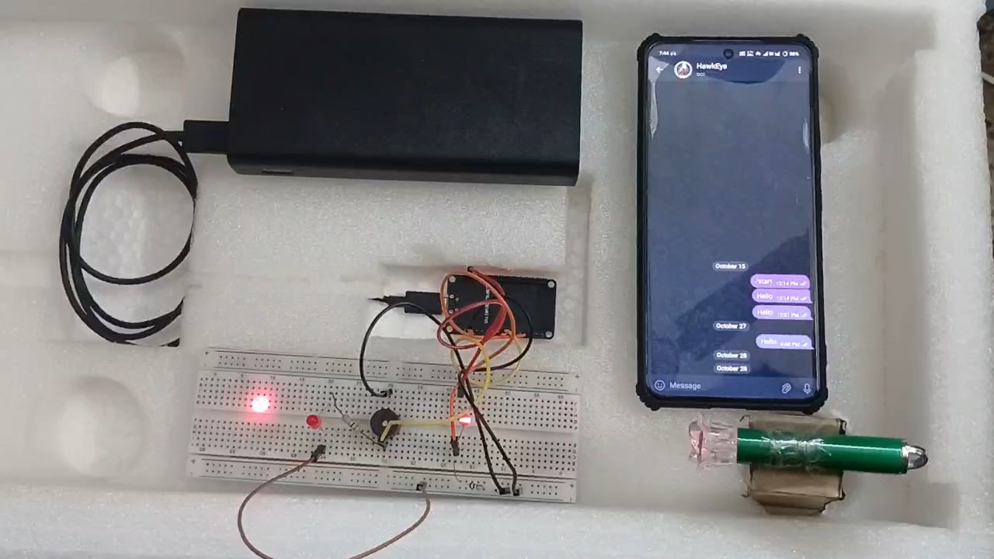
Project Demonstration:

Slide 10
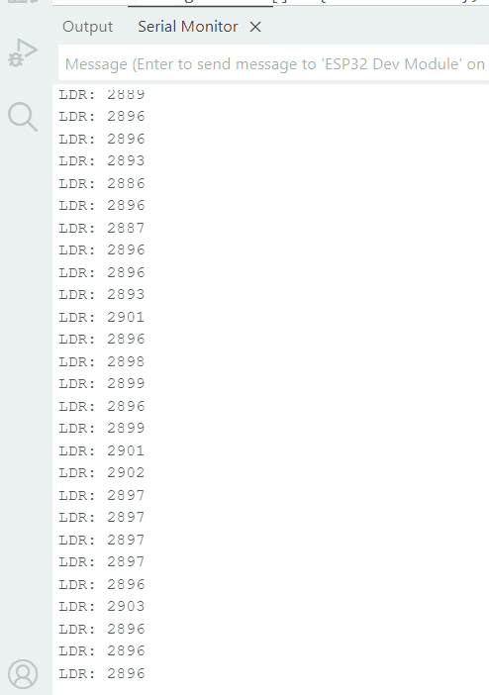
Serial Monitor Output:

Slide 11
Problem Faced during Project:
Arduino UNO R4 Wi-Fi couldn’t connect to APIs due to HTTPS incompatibility.
Telegram Bot through Arduino message system failed for the same HTTPS issue.
SIM800L GSM module didn’t work as Airtel 2G network is very weak.
Power supply to GSM module was unstable, causing frequent resets.
Faced upload and COM port detection errors with different boards.
Had to redesign communication setup multiple times (­Arduino-GSM- ESP-32).
Final setup with ESP-32 and Telegram Bot worked successfully.

Slide 12
Limitations:
The system’s performance may reduce in bright sunlight due to LDR sensitivity.
Laser and LDR alignment must be precise for accurate detection.
Works best indoors; outdoors conditions like dust or fog can affect accuracy.
Currently covers only a small area with one laser-LDR pair.

Slide 13
Possible Solutions:
Place the LDR in a black box with a small hole so that the laser light enters, reducing sunlight interference and improving accuracy.
If there is bright light in the surrounding areas, increase the LDR threshold value so that it only responds to the laser light.
Use multiple LDR- laser pairs for wider area protection.

Slide 14
Future Improvements:
Future versions can include a camera or motion sensor for better security.
Enables voice alerts or smart speaker integration.
Implement GPS tracking for portable or vehicle-based security systems.
Add AI-based detection to reduce false alarms and improve accuracy.
Include battery or solar power backup for outdoor operation.

Slide 15
Result and Discussion:
The system successfully detects any interruption in the laser beam.
When the laser is broken, the LED and buzzer activate instantly, giving a clear local alert.
The ESP-32 connects to Wi-Fi and sends a Telegram message to the user’s mobile within seconds.
The setup works smoothly and accurately under indoor conditions.
It demonstrates how IoT technology enables real-time monitoring and quick alert automation.
The system is low-cost, reliable, and can be expanded for wider security coverage.

Slide 16
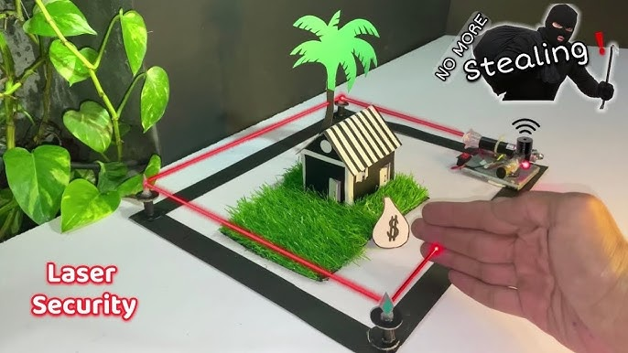
Applications:
Used as a security alarm system for homes, offices, and shops.
Used in farms or gardens to detect and stop animal entry.
Can protect doors, windows, and corridors from unauthorized entry.
Useful in banks, museums, and laboratories for intrusion detection.
Can be applied in parking areas or restricted zones for boundary monitoring.
Detects object passage or obstruction in production lines.

Slide 17
Acknowledgement:
We want to express our heartfelt gratitude to our supervisors, Prof. Saikat Das and Prof. Krishna Kumar, for their continuous guidance, encouragement, and valuable support throughout this project.
We also extend our sincere thanks to Mr. Manas Khan for providing the necessary components and assistance, which greatly helped us in successfully completing our work.

Slide 18
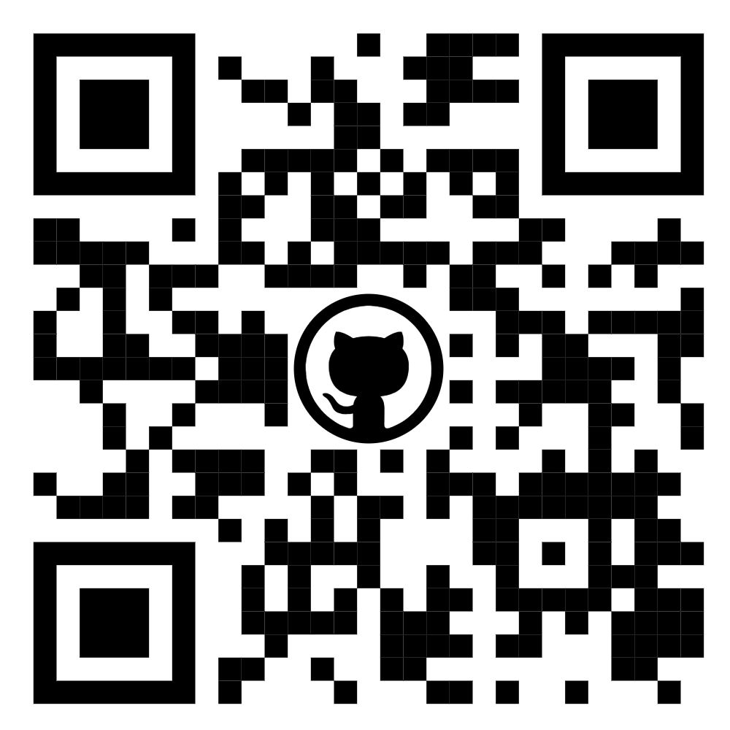
The GitHub link of Project HawkEye:
https://github.com/tanmoy-bhakat/Project-HawkEye

Slide 19
Thank You

